Slide 1
Post Christmas break meeting II.
Fix interpolation
Changing the constants
Amplitude scaling
Observing new interactions 1:4, 1:5
06/02/2023

Slide 2
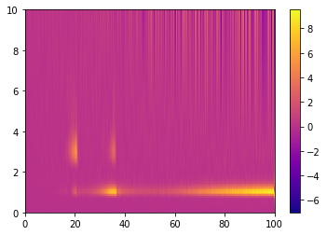
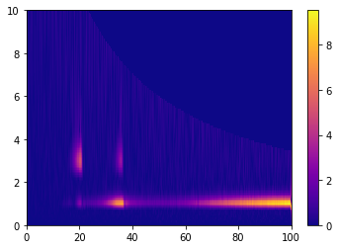
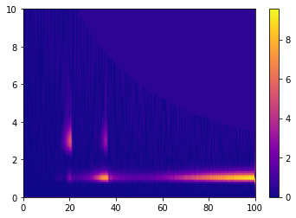
Interpolation
Extrapolate
Fill value = 0
Fill value = 0,5

Slide 3

Interpolation

Slide 4

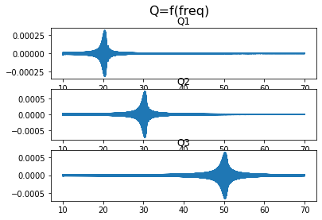
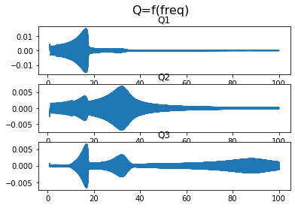
Changing the values of k₁, k₃, w_{i}, F
Last meeting
k₁=0
k₃=10 N.m⁻³
w_{i}= 125.66, 188.50, 314.16
(f=20, 30, 50)
F=10 000
This meeting
k₁=0.0779 N.m⁻¹
k₃=2.516∗10⁶ N.m⁻³
w_{i}= 57.30, 193.75, 552.14
(f=30.84, 30.84, 87.88)
F=100

Slide 5
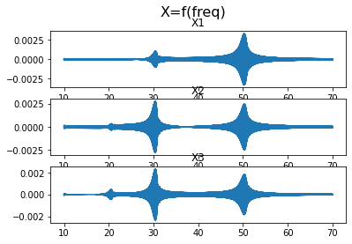
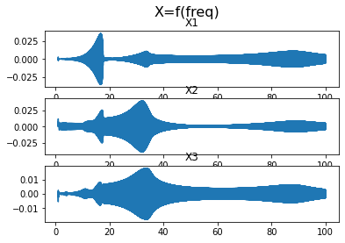
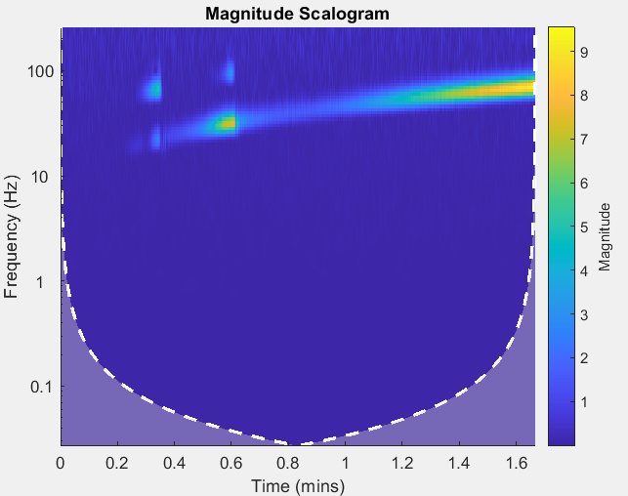
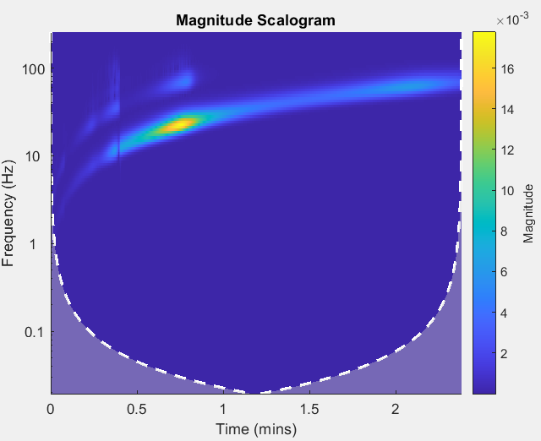
Changing the values of k₁, k₃, w_{i}, F
Last meeting
This meeting

Slide 6
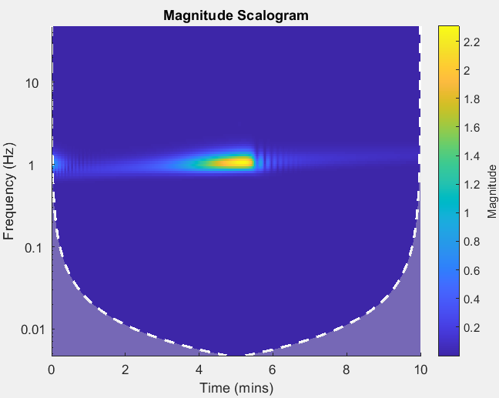
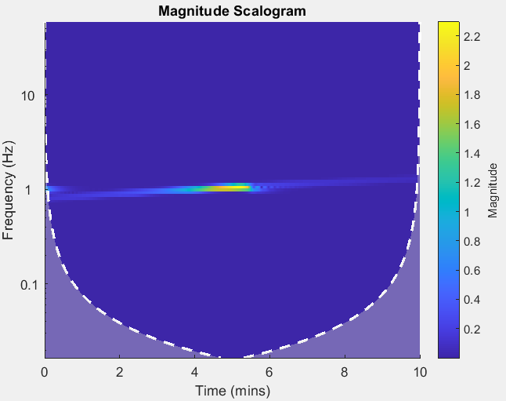
Wavelet choice (1DOF)
Morlet
Bump

Slide 7
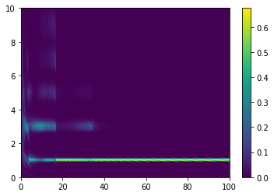
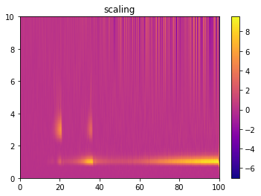
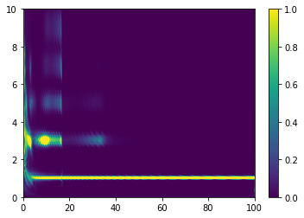
Changing the values of k₁, k₃, w_{i}, F + wvt change
Last meeting
This meeting
Norm 2
Norm calculated by integrating around fnorm=1

Slide 8
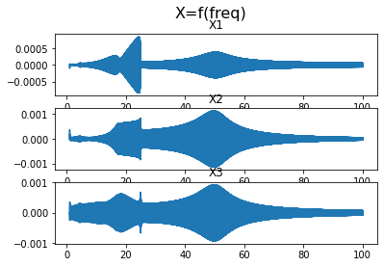
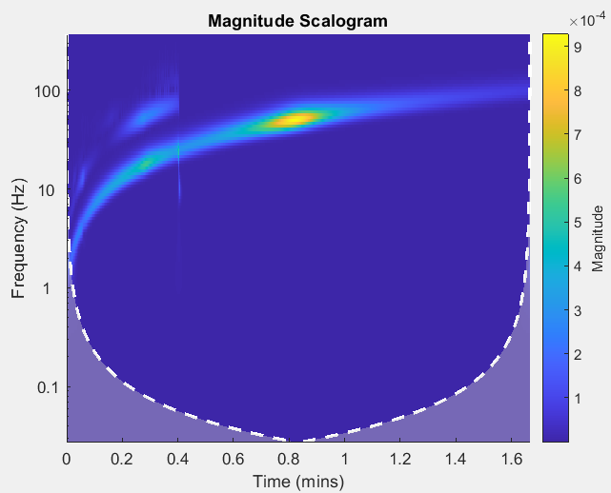
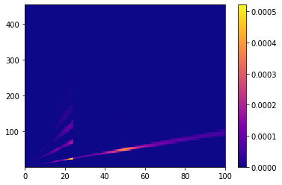
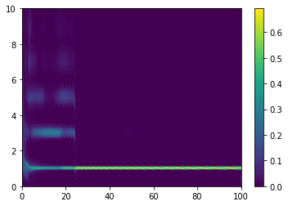
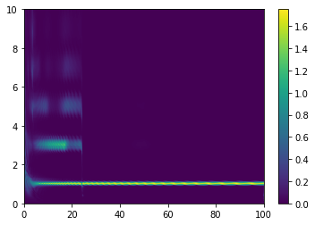
1:5. Harmonics or interaction
Norm around fnorm=1
Norm 2

Slide 9
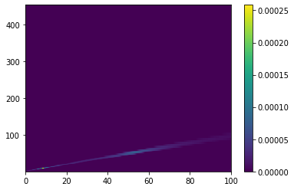
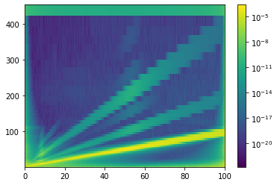
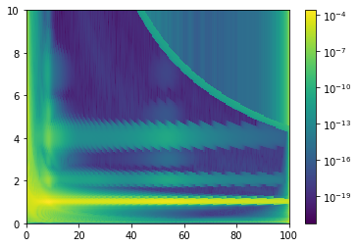
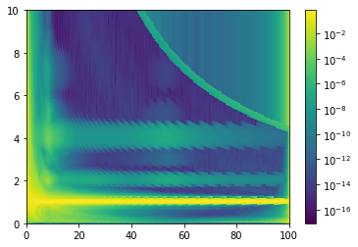

1:4. Harmonics or interaction ?
Frequency scaling
Norm calculated by integrating around fnorm=1
Norm 2
=> Change the percentile of the fill_value

Slide 10
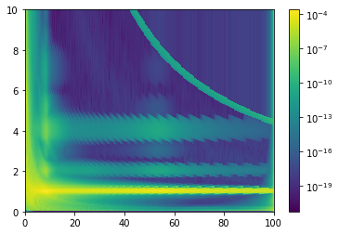
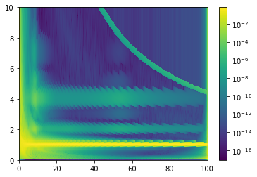

25 percentile => 5 percentile
Frequency scaling
Norm 2
Norm calculated by integrating around fnorm=1

